Slide 1

SIH-2019
Team Name : Machhali Eleven 360
College Name : IIT Bhubaneswar
Team Members:
Basant Kumar
Anand Prakash
Pawan Kumar Saini
Kumari Pratibha
Ankul Kumar
Gourav Barnwal

Slide 2
PROBLEM STATEMENT
In manufacturing, it is important to have predictive maintenance of equipment with sensors, tracking operating conditions & performance of machines, predicting breakdowns, malfunctions, and recommending preventive actions. Tracking parts inventories and monitoring product quality. The failure in the equipment used in the pharmaceutical industries may impact the overall quality of the drug.

Slide 3
FLOW CHART OF THE ENTIRE PROCESS
EQUIPMENTS
SENSORS
DAQ
REMINDER TO OPERATOR FOR MAINTENANCE
SOFTWARE
AI MODEL

Slide 4
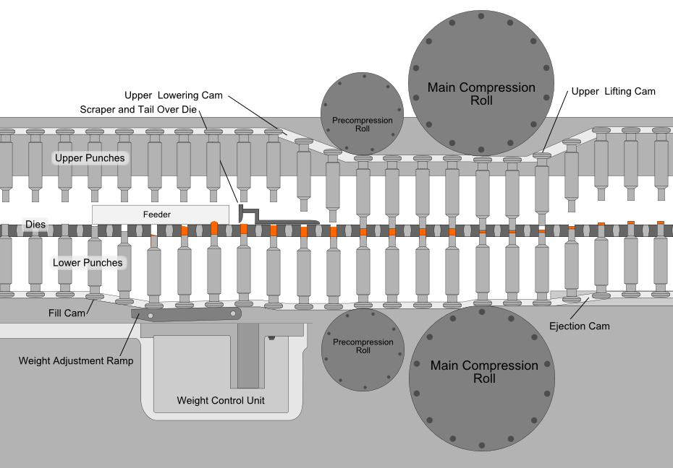
Problems in pharmaceutical industries due to uncertain malfunction
Rotary Tablet Pressing Machine
Involves Powder Filing Compression and Tablet Discharge

Slide 5
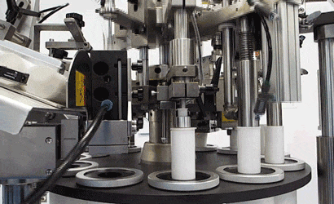
Problems in pharmaceutical industries due to uncertain malfunction
Tube Filling and Sealing Machine
Involve colloidal solution discharge and Sealing

Slide 6
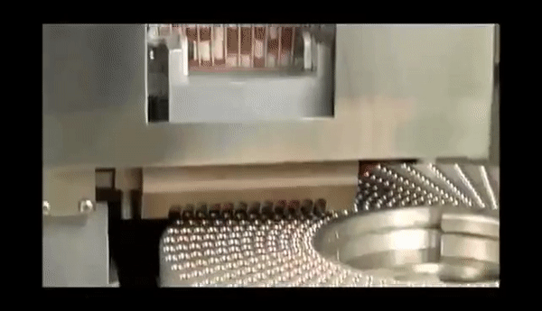
Problems in pharmaceutical industries due to uncertain malfunction
Capsule Filling Machine
Involves Powder and oxidising air filling

Slide 7
Some other Equipments
Agitators: To mix liquids, to promote chemical reactions and to increase heat or cooling transfers.
Blowers: Used in solvent recovery and other evaporation applications.
Boilers: To create steam by applying heat energy to water.
Capsule equipment: Different equipment is available to fill, polish, and sort capsules.
Capsule and tablet printers: For printing information like drug names or dosage on the capsules or tablets.
Centrifuges: Used for separation of liquids of different densities, or for separation of liquids from solids.

Slide 8
Continued...other equipments
Cooling towers: Used for cooling liquids or condensing steam.
Dryers and Granulators: For drying liquid preparations into powders or granules.
Heat exchangers: Used to transfer heat from one medium to another.
High Pressure Homogenizers: The most efficient fluid processing equipment for particle size reduction and cell lysis.
Inspection machines: Allow for visual inspection of the product as it is moved along by rotating rollers.
Metal detectors: For detecting tramp metal (bits of metal like nuts, screws, or broken fragments of machinery) that may have contaminated the product.
Mixers: For blending and particle size reduction.

Slide 9
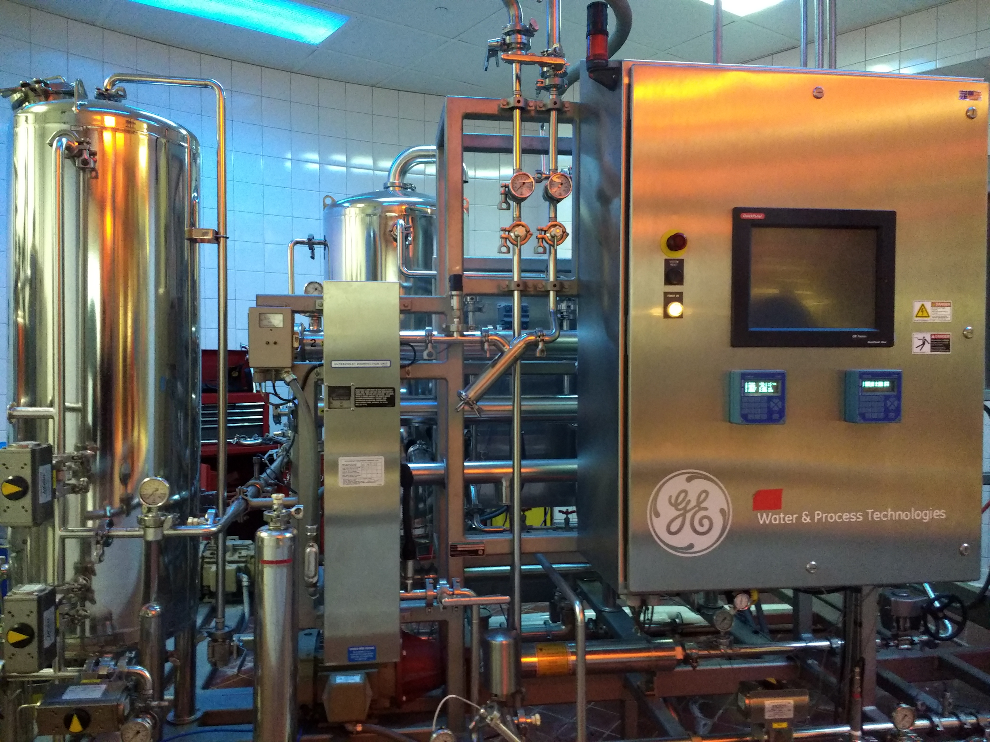

Sending Maintenance reminder through Mobile and Email
A
I
ALGORITHM
Reminder Sent
Through Email
Temperature Sensor
Pressure Sensor
Oxygen Sensor
Moisture Sensor
Tachometer
Weight Sensor

Slide 10
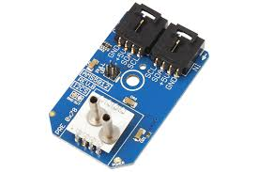
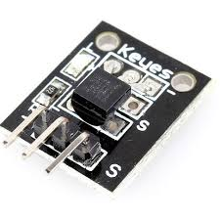
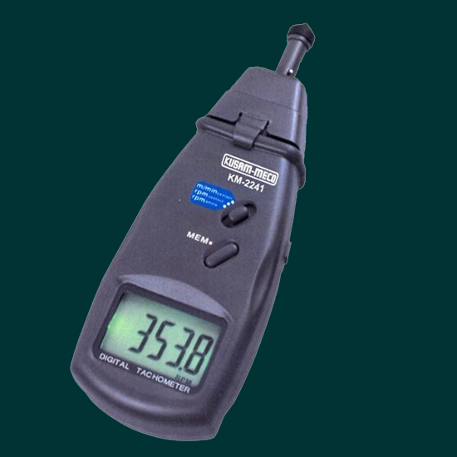
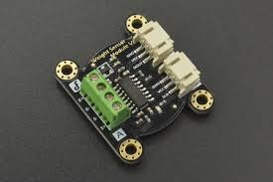
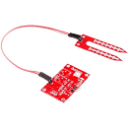
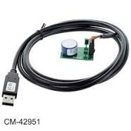
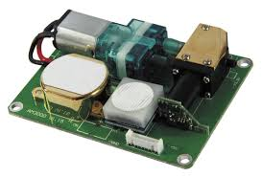
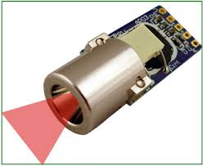
Prerequisites for predictive Maintenance
Weight Sensor
Digital Pressure
Digital Temperature
Tachometer
Moisture Sensor
Oxygen Sensor
Air Quality Sensor
IR Sensor
Data extraction from these sensors

Slide 11
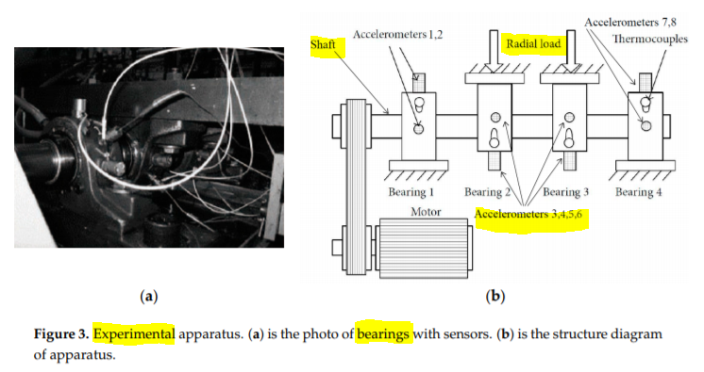
Industrial Setup of Sensor
(a) Photo of Sensors (b)Structure Diagram of Apparatus

Slide 12
Weightage of Every sensor
a=0.45
b=0.35
DATA PROCESSING
c=0.16
d=0.04
LIVE DATA

Slide 13
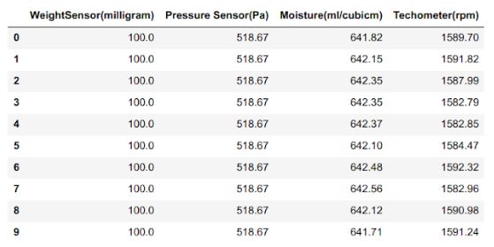
Data Collected from Sensors

Slide 14
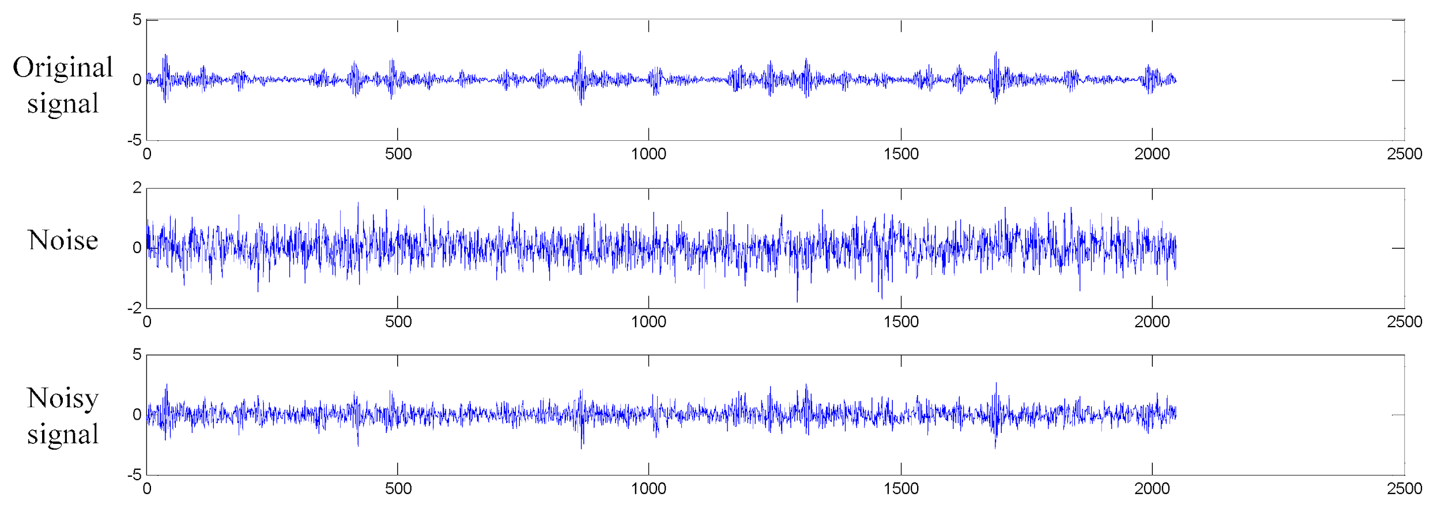
Three Cases of Signals received by Pressure Sensor
Ideal Signal
Noisy Signal from Pressure Sensor(Low SNR)
Noisy Signal from Pressure Sensor(High SNR)

Slide 15


Causes of Breakdown and Malfunction
Malfunction because of fatigueness
Improper maintenance
Poor electrical connections
Overrunning machines - exceed of lifetime
Wear and Tear in machine parts
Improper storage of requisites
Improper Weather Condition
Ignoring warning signals
Untrained operators

Slide 16
Exploring Different-different Solutions
We developed 9 model for the predictive maintenance of the equipments of the pharmaceutical industry. These are
SVM (Linear, RBF and Polynomial)
Random Forest Classifier
Decision Tree Method
K- Nearest Neighbour
Gaussian Bayes Model
Logistic Regression
LSTM: Long Short Term Memory
Different-Different algorithm have different-different task and their performance depends on the dataset, equipment and sensor.

Slide 17
Technology Stacks
Python library/package used: sklearn, scipy, numpy, pandas, matplotlib, os, urllib, tensorflow, keras.
Operating system for operation: Windows.
SMS gateway: to get message about the equipment.
Data preprocessing technology: PCA, whitening, Scaling, normalization.
Others: Jupyter notebook to run the code, spyder as IDE, signal processing system.

Slide 18
Dataset Descriptions
CWRU fault diagnosis dataset:The data-set is provided by the bearing data center of Case Western Reserve University. Tests were conducted using a 2 HP Reliance Electric motor, and acceleration data was measured at locations near to and remote from the motor bearings. Frequency of data generation was 48KHz.
Fault diagnosis bearing dataset IMS: This data-set were collected over the experiments on bearings. The data set was provided by the Center for Intelligent Maintenance Systems (IMS), University of Cincinnati. It’s a kind of classification data-set having class inner race fault, outer race fault, roller element defect and normal. Digital data was collected with the sample rate of 20 kHz for normal vibration and fault vibration.

Slide 19
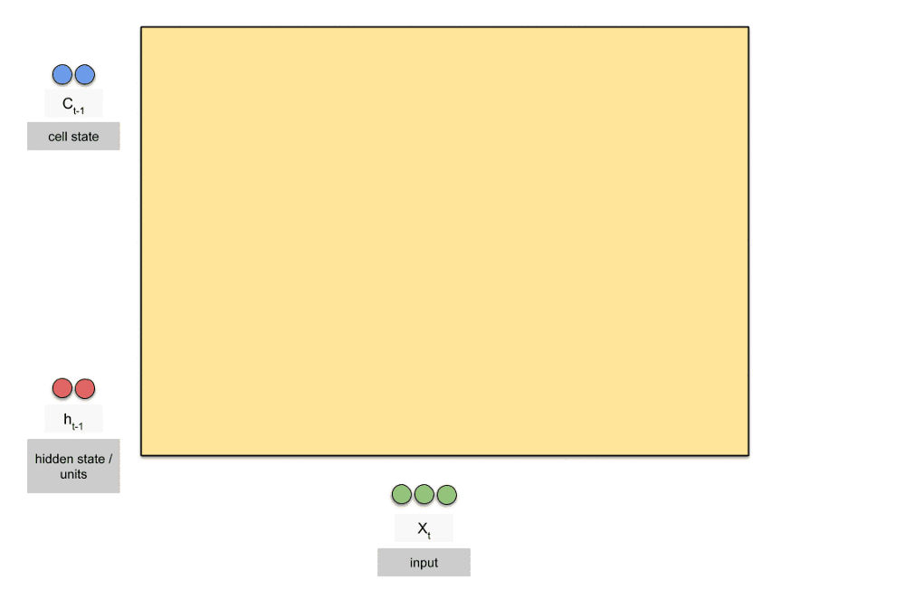
LSTM- Long Short Time Memory

Slide 20
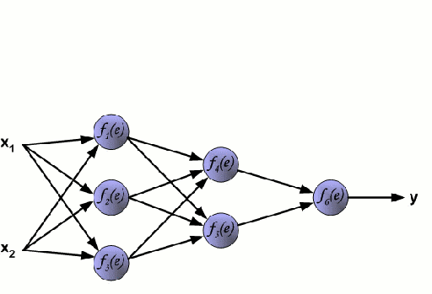
Neural Network Explanation

Slide 21
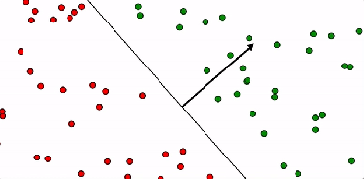
Support Vector Machine

Slide 22
User Flexibility with the model/approach
Generally in industry, we need so many equipment for entire production,maintenance per unit cycle of the pharmaceutical industry. So we have developed a software to tackle all the equipments by a single user. It is very much robust and user friendly to keep track on each equipment by using certain sensor which we have explained in former slide.
Using the python library tkinter we have created a GUI for the user or operator. Our model has a flexibility of showing the live status of equipment that is currently running along with other parameters to visualize the performance of the equipment.

Slide 23
Predictive Solution is a Vital Solution
LSTM
Data Extraction
From different Sensors
Applying Machine Learning Algorithm
ANN
GNB
Required Preventive Solution
Message or Reminder will be sent in mobile
Predictive Mean Time before Failure

Slide 24
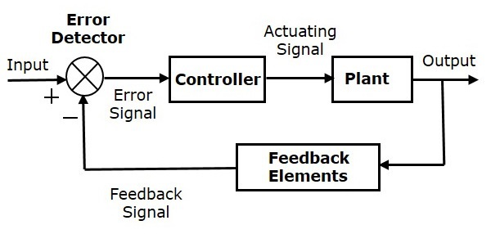
Feedback Control System

Slide 25
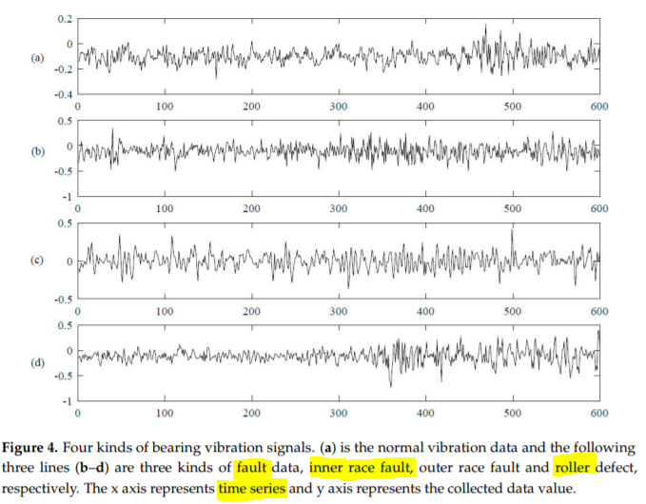
Four Kinds of Vibrational Signal

Slide 26
Inventory Management System
Inventory is a kind of warehouse management system used to store details of the entire raw materials and tools used in industries. Many times a company spends an enormous amount of money on inventory to know the update of raw materials available in warehouse. A manufacturer’s inventory consists of tools, machine parts, raw materials and finished goods. According to the availability of the raw materials and tools, we can remind the warehouse manager to update the tools in warehouse by using this inventory management system.

Slide 27
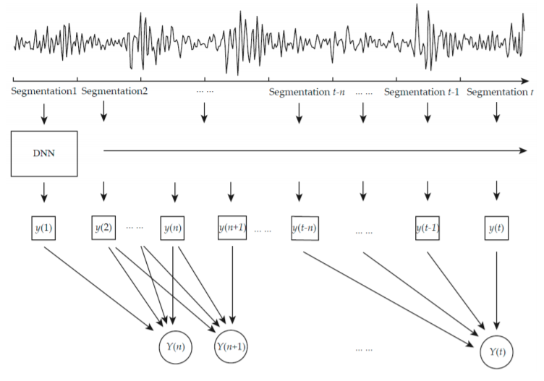
Structure of proposed fault diagnosis model in Pharmaceutical industries

Slide 28
Future scope and other possibilities
Through this problem statement we explored a lot much to get different-different solutions. We take care of every possibility and tried to get some positive out of that. Through our proposed prototype we can help any pharmaceutical industry for their predictive maintenance of equipments used there. It will alert the user before failing the equipment. In pharmaceutical industry sometime an equipment continues working but their performance degrades, so in that situation equipment should be stopped working automatically or manually. One of our proposed model LSTM(Long short term Memory) helps in prediction of equipment based on sequence learning. Although we proposed total of 8 model but 3 out of 8 work better with the dataset used here.
However we explored the given problem in many ways but there is always a chance of possibility over possibilities, solution over solutions, approach over approach. This can be automated in so many ways to reduce the no of user requirements. A robot can do perform every single task for a industry.

Slide 29
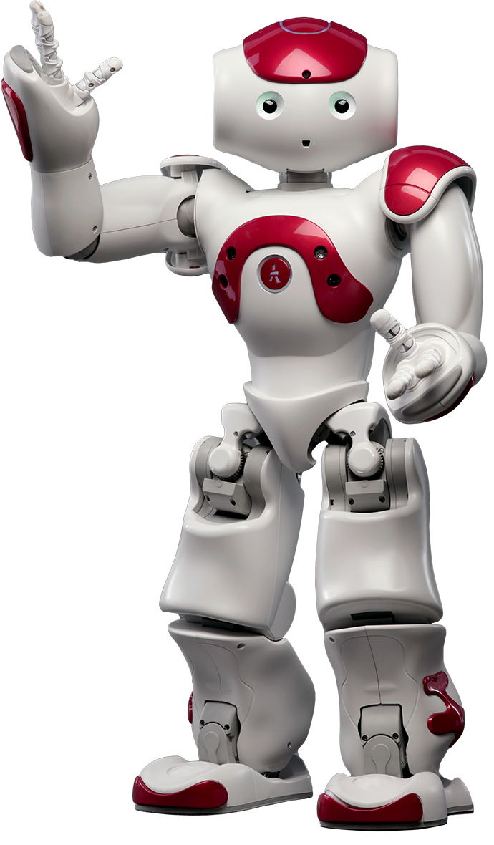
Automation is growing through the help of artificial intelligence.
Industry is much better with Artificial Intelligence .
AUTOMATIC

Slide 30
REFERENCES
https://libraries.mit.edu/data-management/share/find-repository/
https://medium.com/machine-learning-101/chapter-2-svm-support-vector-machine-theory-f0812effc72
http://colah.github.io/posts/2015-08-Understanding-LSTMs/
https://www.finoit.com/blog/top-15-sensor-types-used-iot/
https://www.aaronequipment.com/used-equipment/pharmaceutical-equipment
http://ufldl.stanford.edu/wiki/index.php/UFLDL_Tutorial
https://archive.ics.uci.edu/ml/index.php
https://see.stanford.edu/course/cs229
https://ti.arc.nasa.gov/tech/dash/groups/pcoe/prognostic-data-repository/
https://csegroups.case.edu/bearingdatacenter/pages/welcome-case-western-reserve-university-bearing-data-center-website
https://archive.ics.uci.edu/ml/index.php

